Slide 1
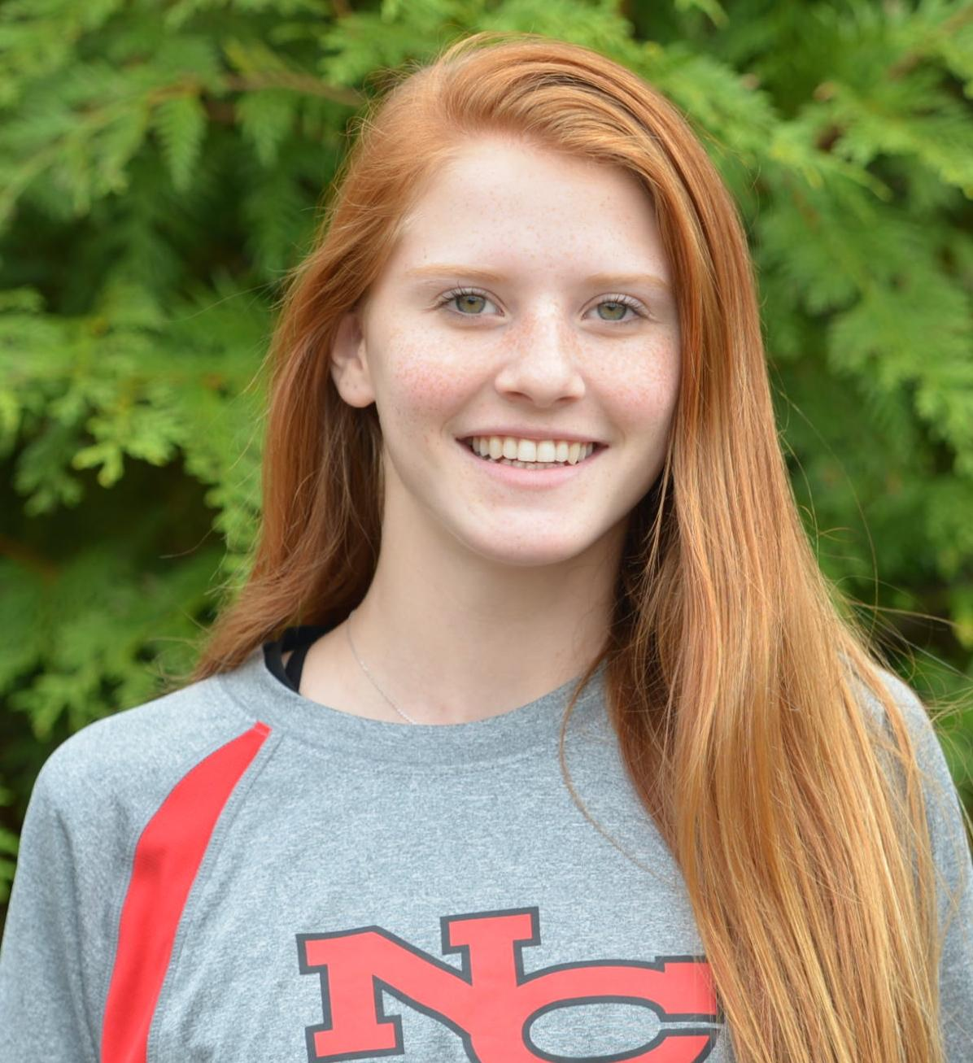
Carson Allsteadt #7
Class of 2018 Opposite
Address Line 1
Address Line 2
Cell:
Email:
STATS
Position: Opposite
Hand: Left
Height: 5’11”
Jersey #: 7
VOLLEYBALL
Club Name - Club Location
Club team information (including team name)
Statistics and accolades
Club Director or Club Coach contact information
High School Name - High School Location
Statistics and accolades
High School Coach contact information
Link to highlight video: https://www.youtube.com/watch?v=h9I7k_Z9PzU&t=3s
ACADEMICS
Graduation Year: 2018
GPA:
ACT/SAT scores:
Academic awards or accolades
EXTRACURRICULAR
Extracurriculars, community service, volunteer work, jobs, etc.
Standing Reach: 7’6”
Block Touch: 9’3”
Approach Touch: 9’9”
Vertical Jump: 27”

